Slide 1

CS1010: Programming Methodology Lecture 3: Top-down Design

Slide 2
Week 3: Top-down Design
Objectives
Able to analyse, design, and implement a program.
Able to break a problem into sub-problems with step-wise refinement.
Able to use built-in library functions.
Able to create your own user-defined functions.
Week3 - 2

Slide 3
Last week’s Exercise (1/2)
Write a program Week2_Freezer.c that estimates the temperature in a freezer (in Celsius) given the elapsed time (hours) since a power failure. Assume this temperature (T) is given by:
where t is the time since the power failure.
Thinking about the algorithm:
What are the variables (and their type) for input data?
What are the variables (and their type) for output?
Is there any formatting of output?
How to compute the result?
2 int variables: hours, minutes
1 float variable: temperature
Yes, 2 decimal places
Use the given formula
Week3 - 3

Slide 4
Last week’s Exercise (2/2)
Week2_Freezer.c
// Estimates the temperature in a freezer (in C)
// given the elapsed time (hours) since a power failure.
#include <stdio.h>
int main(void)
{
int hours, minutes;
float time, temperature;
printf("Enter hours and minutes since power failure: ");
scanf("%d %d", &hours, &minutes);
time = hours + minutes/60.0; // convert hour & minute to hours
temperature = 4 * time * time / (time + 2) - 20;
printf("Temperature in freezer = %.2f\n", temperature);
return 0;
}
preprocessor directives
main function
avoid integer division
return 0 to the caller of this function
Week3 - 4
Notes:
For the int main(void) function, theoretically we can return any integer value, but we usually return 0 because the exit code 0 usually means a successful run (esp. when run in UNIX environment).
We can have the function return different values on different conditions (e.g., in an 'if' statement) to indicate under what circumstance did the program end.
Exit code is useful if we need to check the termination status of a program after the program is run (for some follow-up action), though we don’t make use of it in this course.

Slide 5
Math Functions (1/2)
In C, there are many libraries offering functions for you to use.
e.g., functions scanf and printf are from library <stdio.h>
In the previous program, you may write t² as t*t, or use the pow function in the math library: pow(t, 2).
pow(x, y) // compute x raised to the power of y
Week3 - 5

Slide 6
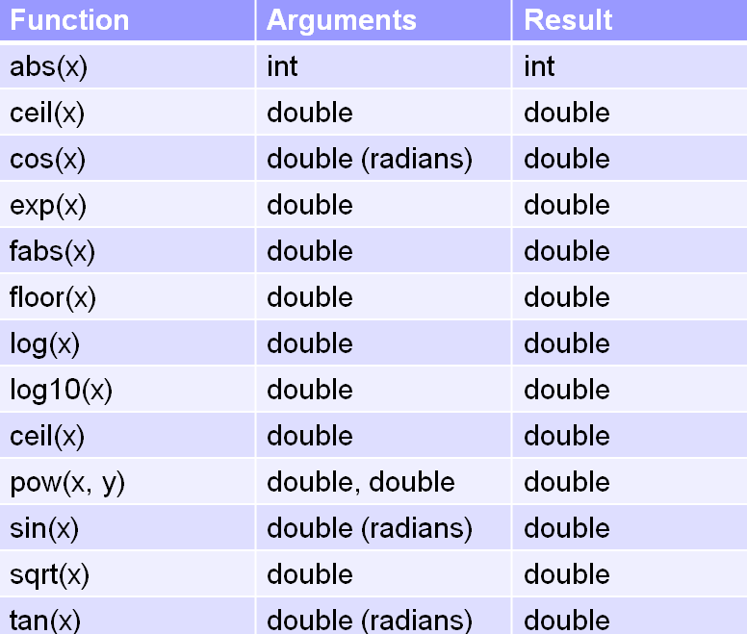
Math Functions (2/2)
Some useful Math functions
function abs(x) is from <stdlib.h>; the rest are from <math.h>
To use math functions in your program:
include <math.h> in your program
compile the program with -lm option gcc -Wall xxx.c -lm
Week3 - 6

Slide 7
Ex 1: Freezer with Revised Formula
Write a program Week3_Freezer_New.c that replaces the old formula with the following one. All other statements remain the same.
Enter hours and minutes since power failure: 2 30
Temperature in freezer = -10.01
cp Week2_Freezer.c Week3_Freezer_New.c
Q: Have you included <math.h> header file?
Q: Have you turned on "-lm" option in compilation?
Week3 - 7

Slide 8
Problem Solving Strategies (1/2)
Given a problem, how to proceed to reach a working program?
Determine problem features
Analysis
Design algorithm
Design
Rethink as appropriate
Write code
Implementation
Check for correctness (and efficiency)
Testing
Week3 - 8

Slide 9
Problem Solving Strategies (2/2)
Analysis and Design
stepwise
refinement
NO
( hierarchy of )
sub-problems
Incorrect
problem
statement
sub-problems can
be implemented ?
YES
Implementation
& Testing
Knowledge in C
and its libraries
Knowledge in
data structures
(mostly CS1020)
Knowledge in
algorithms
Week3 - 9
Notes:
When implementation and testing did not give the expected outcome, go back to the analysis and design again.

Slide 10
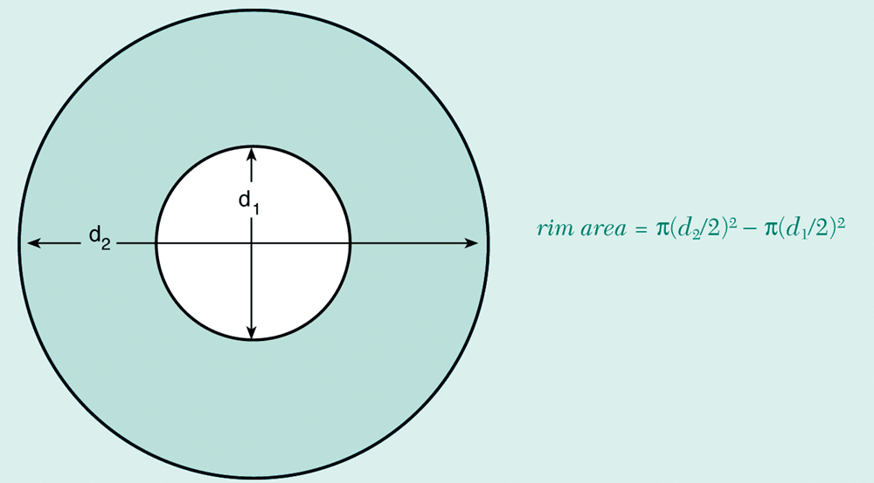
Case Study: Top-down Design (1/5)
You work for a hardware company that manufactures flat washers. To estimate shipping costs, your company needs a program that computes the weight of a specified quantity of flat washers.
rim area = π(d₂/2)² – π(d₁/2)²
Week3 - 10

Slide 11
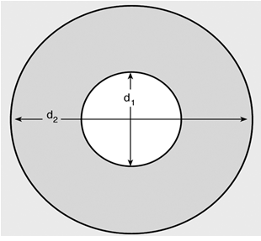
Case Study: Top-down Design (2/5)
Analysis:
To get the weight of a specified qty of washer, we need to know the weight of each washer
To get the weight of a washer, we need its volume × density
To get volume, we need its rim area × thickness
To get the rim area, we need d2 and d1
qty, density, thickness, d2, d1 should be given as inputs.
Answer
qty
weight
volume
density
rim area
thickness
rim area = π(d₂/2)² – π(d₁/2)²
d2
d1
Week3 - 11

Slide 12
Case Study: Top-down Design (3/5)
Analysis:
We define what the inputs and outputs are
Design:
Algorithm (expressed in words):
Read in all the necessary inputs (qty, density, thickness, d2, d1)
Compute weight of a single washer
2.1 Compute the area of the (small) hole using d1
2.2 Compute the area of the (big) circle using d2
2.3 Subtract the big area from the small area to get the rim_area
2.4 Compute volume = rim_area × thickness
2.5 Compute weight = volume × density
Compute the weight of a specified number of washer = weight × qty
Output the calculated weight
Week3 - 12
Notes:
In reality, you need to decide input and output by yourself
This is our decomposition outline

Slide 13
Case Study: Top-down Design (4/5)
Design:
Algorithm (expressed in Structure Chart)
Compute Total Weight
Input: qty, density, thickness, d1, d2
Compute Weight of a single washer
Output total weight
Compute total Weight
Compute circle area
divide and conquer strategy
Week3 - 13

Slide 14
Case Study: Top-down Design (5/5)
Week3_WashersWeight.c
#include <stdio.h>
#include <math.h>
#define PI 3.14159
int main(void)
{
double d1; // input hole circle diameter
double d2; // input big circle diameter
double thickness; // thickness of a washer
double density; // density of a washer
int qty; // how many washers?
double unit_weight; // single washer's weight
double total_weight; // a batch of washers' total weight
double inner_area; // area of inner hole
double outer_area; // area of outer circle
double rim_area; // single washer's rim area
// ask for all the inputs
printf("Inner diameter in centimeters: ");
scanf ("%lf", &d1);
we will use library function pow later

Slide 15
printf("Outer diameter in centimeters: ");
scanf ("%lf", &d2);
printf("Thickness in centimeters: ");
scanf ("%lf", &thickness);
printf("Material density in grams per cubic centimeter: ");
scanf ("%lf", &density);
printf("Quantity in batch: ");
scanf ("%d", &qty);
// compute weight of a single washer
inner_area = pow(d1/2, 2) * PI;
outer_area = pow(d2/2, 2) * PI;
rim_area = outer_area - inner_area;
unit_weight = rim_area * thickness * density;
// compute weight of a batch of washers
total_weight = unit_weight * qty;
printf("The total weight of the batch of %d washers "
"is %.2f grams\n", qty, total_weight);
return 0;
}
To compile this program:
gcc -Wall Week2_WashersWeightV1.c -lm
Week3 - 15

Slide 16
Case Study: Functions (1/5)
Week3_WashersWeight.c
printf("Thickness in centimeters: ");
scanf ("%lf", &thickness);
printf("Material density in grams per cubic centimeter: ");
scanf ("%lf", &density);
printf("Quantity in batch: ");
scanf ("%d", &qty);
inner_area = pow(d1/2, 2) * PI;
outer_area = pow(d2/2, 2) * PI;
rim_area = outer_area - inner_area;
unit_weight = rim_area * thickness * density;
// compute weight of a batch of washers
total_weight = unit_weight * qty;
printf("The total weight of the batch of %d washers "
"is %.2f grams\n", qty, total_weight);
return 0;
}
A bit duplicated
Notes:
Here we repeat the formula twice, each time with different diameter. It’s still ok because the duplicated code is just one line. But there could be other cases where your duplicated code is a big trunk. Then you would need to think about a better design to avoid duplication.

Slide 17
Case Study: Functions (2/5)
Area of circle is computed twice (with the only difference of parameter d1 and d2).
For code reusability, can we define a function to calculate area of circle?
We may invoke this function whenever we need to calculate area of circle.
Just give diameter, the function shall tell me corresponding area
circle_area(d2) → to compute area of a circle with diameter d2
circle_area(d1) → to compute area of a circle with diameter d1
Week3 - 17

Slide 18
Case Study: Functions (3/5)
return type
function name
parameter
function header
double circle_area(double diameter)
{
return pow(diameter/2, 2) * PI;
}
// function to calculate area of a circle
function body
Function header
consists of return type, function name, and a list of parameters (with their types) separated by commas.
Function body
code to perform the task; may return a value to the caller.
Function call circle_area(2) will return 3.14159
Function call circle_area(4) will return 12.56636
Week3 - 18
Notes:
Parameter is a variable. Whoever call this function will need to supply a value to the parameter

Slide 19
Case Study: Functions (4/5)
#include <stdio.h>
#include <math.h>
#define PI 3.14159
double circle_area(double diameter) // function circle_area
{
return pow(diameter/2, 2) * PI;
}
int main(void)
{
// variable definitions...
// other computations...
inner_area = pow(d1/2, 2) * PI;
outer_area = pow(d2/2, 2) * PI;
rim_area = outer_area - inner_area;
// ...
return 0;
}
This is the first function call
inner_area = circle_area(d1);
outer_area = circle_area(d2);
This is the second function call
Notes:
Return value will replace the function call for further calculation. So caller will continue doing 12.56636 – 3.14159 and assign result to variable rim_area.

Slide 20
Case Study: Functions (5/5)
Preferred style: add function prototype before the main() function
Parameter names may be omitted, but not their type
#include <stdio.h>
#include <math.h>
#define PI 3.14159
double circle_area(double);
int main(void)
{
// variable definitions...
// other computations...
inner_area = circle_area(d1);
outer_area = circle_area(d2);
rim_area = outer_area - inner_area;
// ...
return 0;
}
double circle_area(double diameter)
{
return pow(diameter/2, 2) * PI;
}
Function prototype is needed if the caller is defined before the function been called
Function definition is placed after the caller, main function in this example
Notes:
In function prototype, you may just give the type of parameters and skip their names. You may even put parameter names there, but will be ignored by the compiler.

Slide 21
Exercise #2: Speed of Sound
Write a program that calculates the speed of sound (a) in air of a given temperature T (ºF). Formula to compute the speed a in ft/sec:
(This is a true story) Being unable to correct compilation errors, one of the students sent me his code, which can be downloaded as follows:
Help your friend by trying to understand his code, and modifying it until it is error-free.
cp ~cs1010/lecture/Week3_SpeedOfSound.c .
Temperature in degree Fahrenheit: 95.8
Speed of sound in air of 95.80 degree = 1924.92 ft/sec
Week3 - 21
Notes:
Pay attention to (1) syntax error; (2) coding style

Slide 22
Another Example (1/3)
// return square root of (x^2 + y^2)
double sqrt_sum_square(double x, double y)
{
double sum_square; // local variable
sum_square = pow(x, 2) + pow(y, 2);
return sqrt(sum_square);
}
Arrows indicate flow of control between main and a function been called.
int main(void)
{
double a = 1.23;
double b = 4.56;
double c = sqrt_sum_square(a, b);
printf("The distance of (%.2f, %.2f) ", a, b);
printf("to origin is: %.2f\n", c);
return 0;
}
The distance of (1.23, 4.56) to origin is: 4.72
Week3 - 22

Slide 23
Another Example (2/3)
formal parameters
double sqrt_sum_square(double x, double y)
{
double sum_square; // local variable
sum_square = pow(x, 2) + pow(y, 2);
return sqrt(sum_square);
}
int main(void)
{
double a = 1.23;
double b = 4.56;
double c = sqrt_sum_square(a, b);
printf("The distance of (%.2f, %.2f) ", a, b);
printf("to origin is: %.2f\n", c);
return 0;
}
a, b are actual parameters
Values of actual parameters are copied to function for computation.
Formal parameters are placeholders to receive values.
Matching of actual and formal parameters is from left to right
Scope of formal parameters, local variables is within the function only
Week3 - 23
Notes:
The scope of variables / parameters is the function in which they are defined.
Formal parameter and actual parameter are different variables, belonging to callee and caller respectively.
Normally we give them different names, but even with the same names (e.g., replace 'x' with 'a' and 'y' with 'b'), they are still different memory slots (with different memory addresses). Compiler will be able to differentiate them.

Slide 24
Another Example (3/3)
#include <stdio.h>
#include <math.h>
double sqrt_sum_square(double, double); // prototype
int main(void)
{
double a = 1.23;
double b = 4.56;
double c = sqrt_sum_square(a, b);
printf("The distance of (%.2f, %.2f) ", a, b);
printf("to origin is: %.2f\n", c);
return 0;
}
// return square root of (x^2 + y^2)
double sqrt_sum_square(double x, double y)
{
double sum_square;
sum_square = pow(x, 2) + pow(y, 2);
return sqrt(sum_square);
}
The complete program of Week3_Distance.c:
Week3_Distance.c
these a, b, c are local to main function
such x, y, sum_square are local to this function
Week3 - 24

Slide 25
Functions (1/3)
General format of 4 kinds of functions
// takes no parameter
// returns nothing
void funcA (void)
{
printf("Welcome on board!\n");
return;
}
// takes no parameter
// (can omit 'void')
// returns a double value
double funcB ()
{
return 3.1415926;
}
// takes a parameter
// returns nothing
void funcC (int par)
{
printf("%d\n", par);
}
// takes two parameters
// returns a double value
double funcD (double a, double b)
{
return a + b;
}
It’s your design how many parameters a function will take and whether it will return a value or not, depending on the purpose of this function.
Week3 - 25
Notes:
If a function takes no parameter, then parameter list can be empty or "void".
When all statements are executed, a function returns to caller naturally. Or if a "return" statement is met, control will also return to the caller instantly.
As a programmer, it’s your design how many parameters a function will take and whether it will return a value or not.

Slide 26
Functions (2/3)
preprocessor directives
function prototypes
main function
{
variable declarations
executable statements
}
function1 header
{
variable declarations
executable statements
}
function2 header
{
variable declarations
executable statements
}
more function definitions..
A function is a block of code solving a task / sub-task.
A function takes zero or more input parameters, and returns zero or one return value.
Return value (if any) from function call may be used (or be skipped) by the caller.

Slide 27
Functions (3/3)
Good practice: writing pre-condition of a function.
describes conditions that should be true before calling a function.
Ex 2: Calculate speed of sound from temperature:
double spd_of_sound(double temperature)
{
return 1086 * sqrt ( (5*temperature + 297) / 247 );
}
// pre-condition: temperature >= -59.4
Sometimes we also write post-condition.
describes conditions that will be true after executing a function.
Week3 - 27

Slide 28
Ex #3 (take-home): Magic Number
Write a program Week3_MagicNumber.c that reads two positive integers (with at most 5 digits) and for each, adds up the digits (from right) in positions 1, 3, and 5. The right-most digit of the sum is the required answer.
For example, if input is 76524, then adding up the digits 4, 5 and 7, we get 16. The answer is hence 6.
You should define a function get_magic to compute and return the answer. Determine the parameter list and return type of this function by yourself.
* This exercise is mounted on CodeCrunch as a self-practice exercise.
Enter 1st value: 76524
Magic number = 6
Enter 2nd value: 8946
Magic number = 5
Week3 - 28

Slide 29
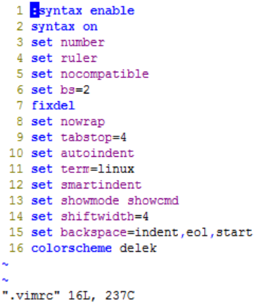
.vimrc and gcc
Self-read
.vimrc
Configuration file that controls how your vim looks and works.
Downloaded to your UNIX home directory when you run setup script.
May view or change its contents using vim
gcc
Only source code will be submitted to CodeCrunch, therefore how you name your executable file (a.out or whatever) is not important.
Common errors/warnings at this point:
Missing & (address operator) in scanf() function
Forget to use -lm option when program uses math functions
Forget to initialize a variable before using its value.
Week3 - 29

Slide 30

Summary for Today
Today’s most important lessons
Acquaintance with Math library functions
pow, sqrt …
Top-down design for problem solving: divide and conquer strategy
Modular programming with functions
Function definition and function prototype
Flow of control in function call
Actual parameter and formal parameter
Different types of functions
Precondition, post-condition
Week3 - 30

Slide 31
End of File

